Slide 1

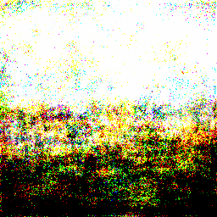
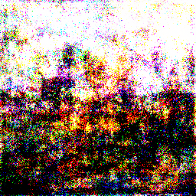
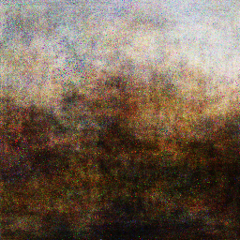
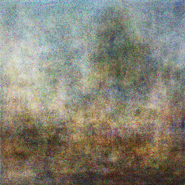
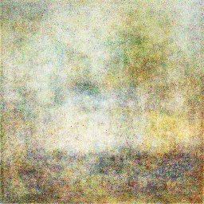
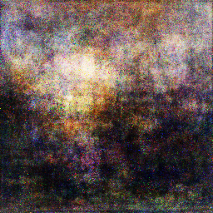
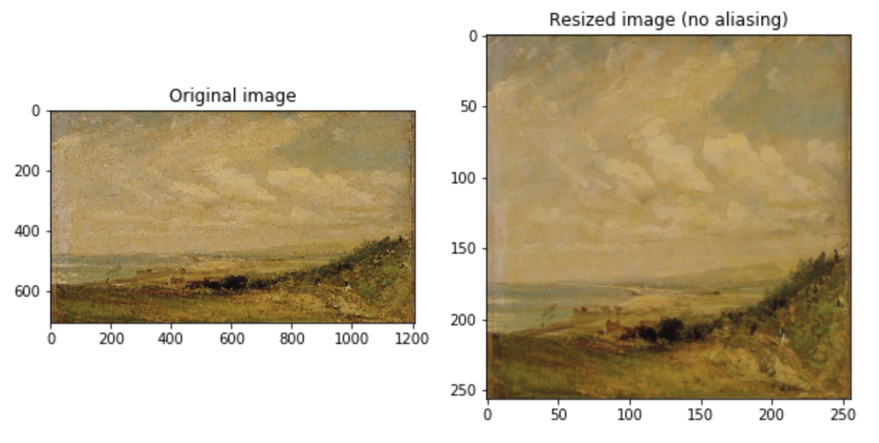
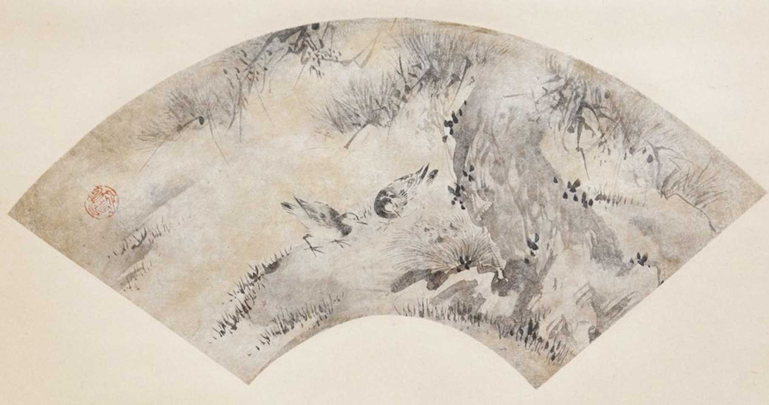
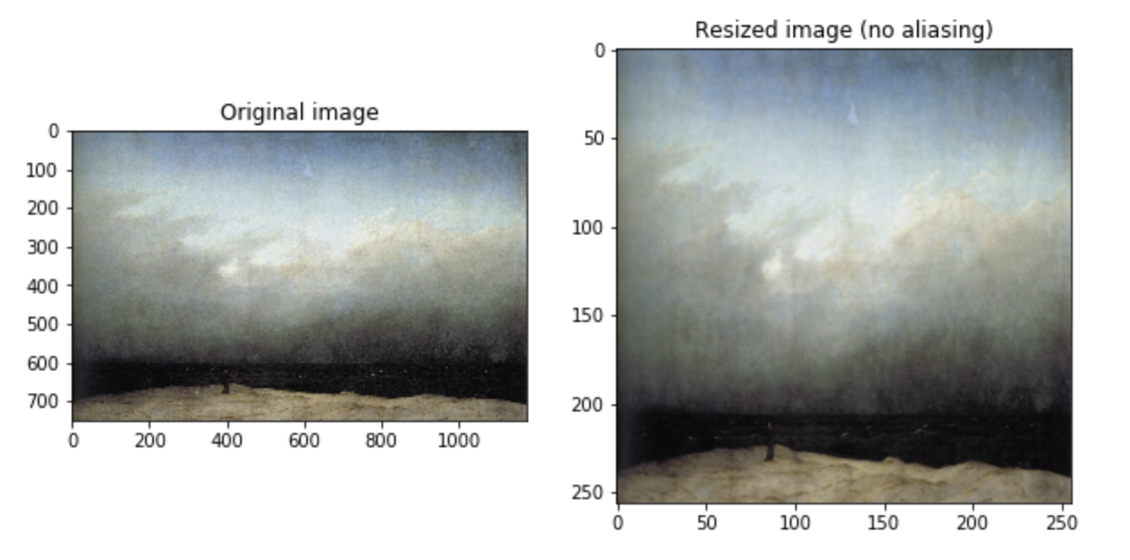
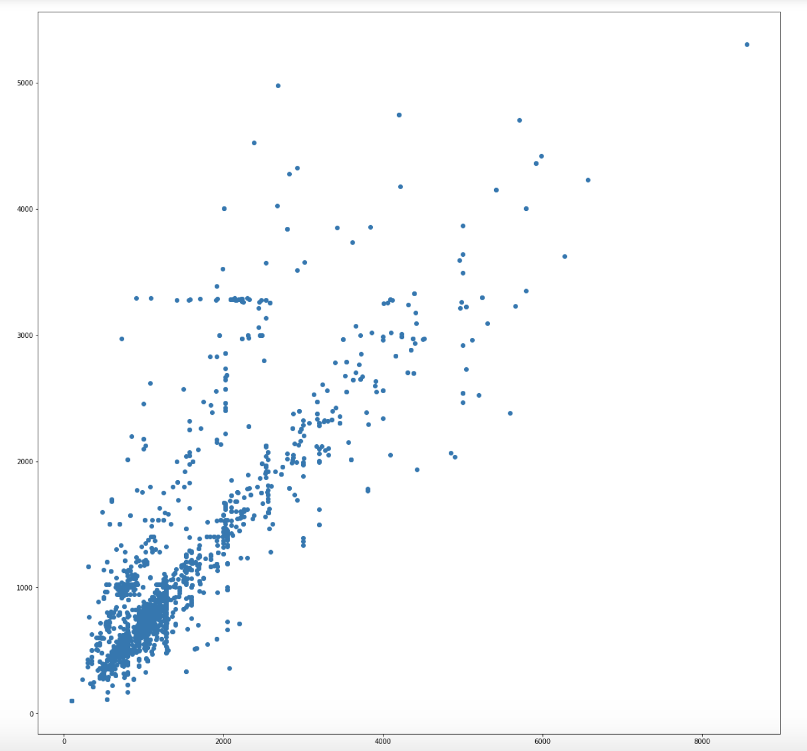
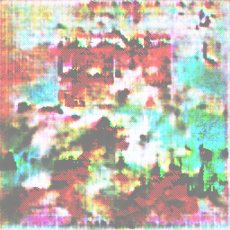
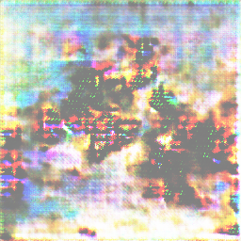
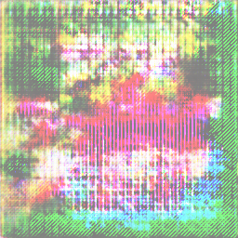
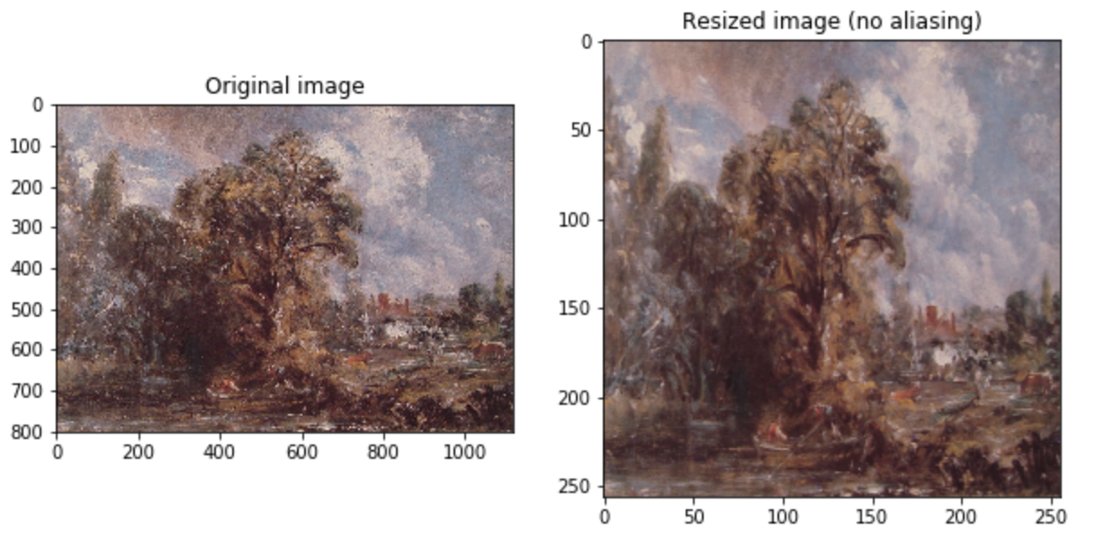
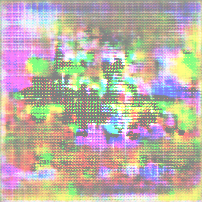
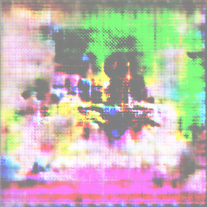
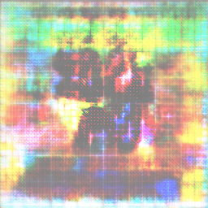
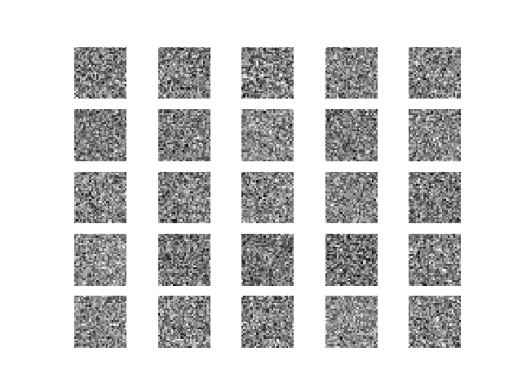
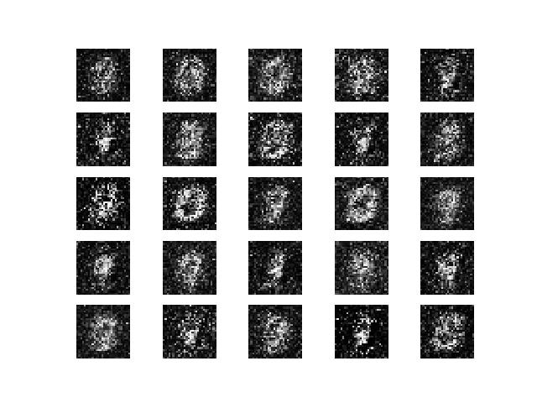
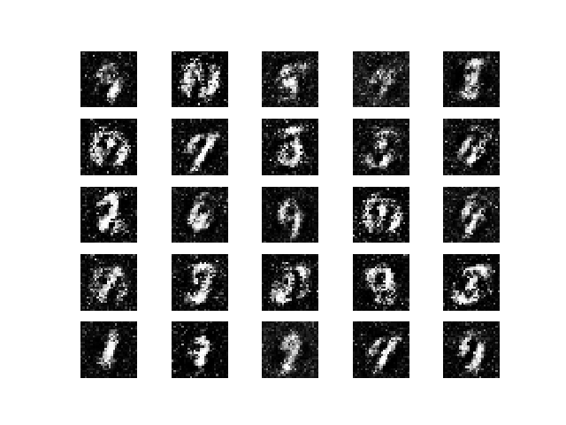
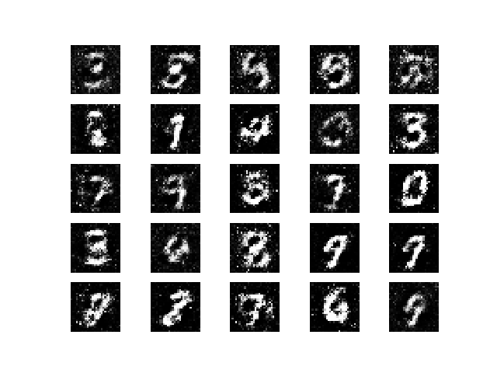
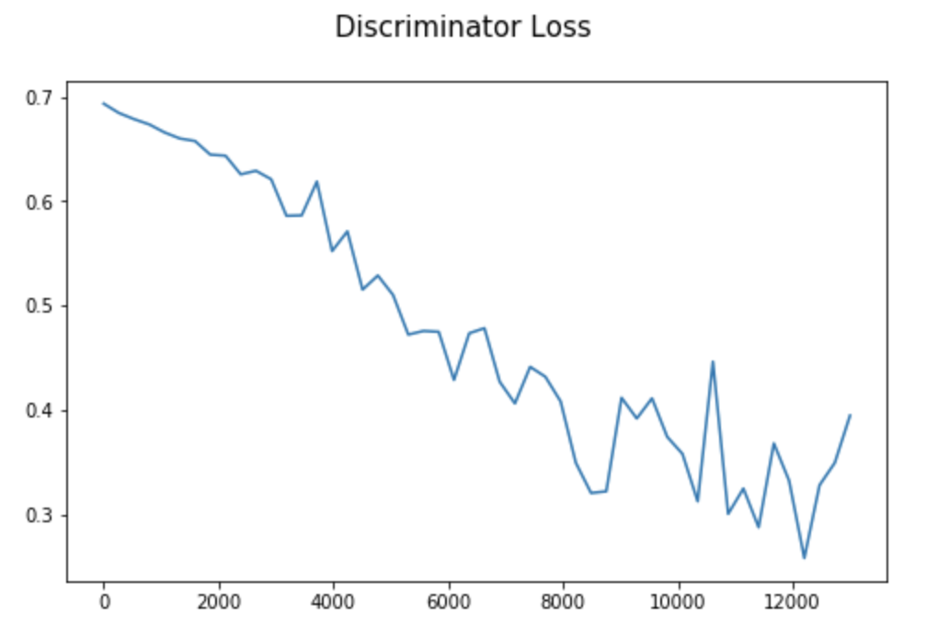
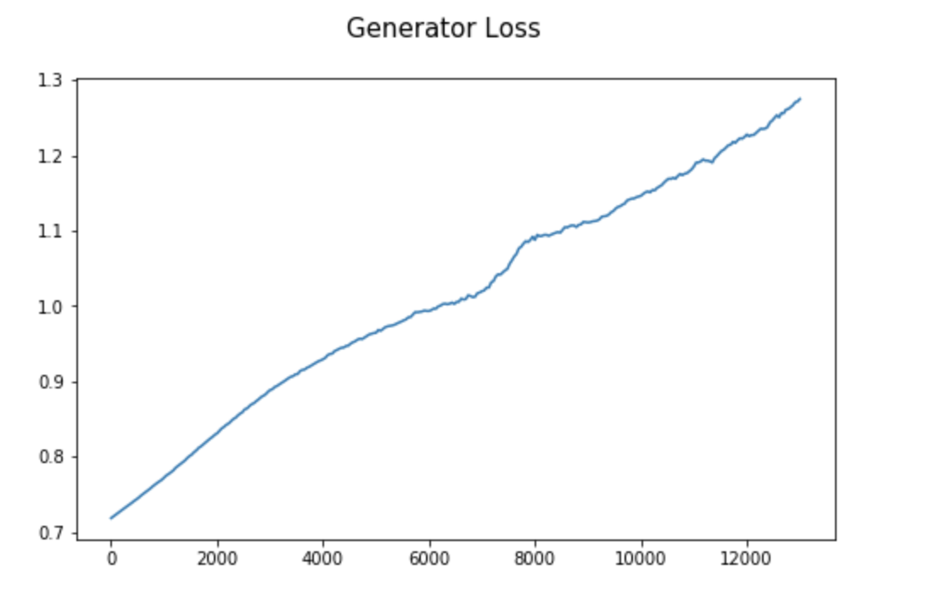
COMP 576 Intro to Deep Learning Final Project - Artificial Art
Jonathan Cai (jmc31), Skylar Xu (yx48)
Rice University, Computer Science Department
Abstract
WikiArt Results
Figure 5. Overall GAN Architecture. We’ve defined the latent space (the random noise) to be R¹⁰⁰ . Also, this diagram depicts the MNIST dataset, but our dataset is much more complicated images of landscapes.
We attempt to replicate studies that have generated art by using Generative Adversarial Networks (GANs), simulating a given distribution of images. The novelty of this project comes in the comparison between the use of SOTA architectures that utilize transpose convolutional layers and the results of a simpler model that utilizes only densely connected layers. We also explore both methods on the MNIST dataset and images of landscapes from WikiArt.
Densely connected model results:
At first glance, results from the simplified dense layered model appear to be very abstract paintings. You can barely sense out some simple landscape features –the darker lower portion of the image depicting land, and the lighter upper portion of the image depicting air/sky. The generator does appear to abstract away the smaller detailing of the image distribution, while maintaining the overall, top-bottom structure of the landscape style images. As expected, this model performs worse on a more complicated dataset like the WIkiArt landscape images that contains far more variation across images, as compared to the results shown on the MNIST dataset.
Convolutional model results:
The results from the complex convolutional layered model don’t really show any distinctive features (even after 125,00+ epochs of training). We can also clearly see patterns in the pixels as produced by the transpose convolutional layers. It appears that the generator is not able to converge in any substantial way, and we suspect that this is due to the discriminator learning significantly faster than the generator, as evidenced in Figure 4. This hypothesis is also supported by the fact that our discriminator is more complicated, has far more trainable parameters, as compared to the generator in this model.
Architecture
Data/Preprocessing
As depicted in the figure above, a typical GAN involves two models, the generator and discriminator. During training, the generator produces fake images, and then the discriminator is fed both fake images and real images from the “ground truth” dataset. The results are then backpropagated through both networks. We ended up using two architectures, one more computationally feasible and using only dense layers (described on the left), and one more computationally expensive, using convolutional and transpose convolutional layers (described on the right).
Hyper-Parameters:
Adam Optimizer w/ 0.0001 learning rate
LeakyReLU w/ 0.2 alpha
Batch size 128
Generator:
Input Noise (100x1)
Dense 256
Leaky ReLU
Batch Norm
Dense 512
Leaky ReLU
Dense 1024
Leaky ReLU
Batch Norm
Dense (256x256x3)
Tanh
Total trainable parameters: 202,209,536 Discriminator:
Dense 512
Leaky ReLU
Dense 256
Leaky ReLU
Dense 1
Sigmoid
Total trainable parameters: 100,795,393
Generator : (TC = Transpose Convolutional)
Input Noise (100x1)
TC 4 x 4 x 1024
TC 8 x 8 x 1024
TC 16 x 16 x 512
TC 32 x 32 x 256
TC 64 x 64 x 128
TC 128 x 128 x 64
Image 256 x 256 x 3
Total trainable parameters:
28,458,505
Discriminator :
Convolutional 32 4 × 4
Leaky ReLU
Convolutional 64 4 × 4
Leaky ReLU
Convolutional 128 4 × 4
Leaky ReLU
Convolutional 256 4 × 4
Leaky ReLU
Convolutional 512 4 × 4
Leaky ReLU
Convolutional 512 4 × 4
Leaky ReLU
Dense 1024
Dense 512
Dense 1
Trainable parameters: 1,073,909,633
Dataset:
The images used to train our GAN are from WikiArt (Visual Art Encyclopedia).
Preprocessing:
The performed preprocessing was simple. We scaled every image in our dataset into dimensions 256 x 256. We also needed to prune the dataset, removing images that were far too small to be reasonably comprehensible (there was a cluster of 100 x 100 images) and images that were simply not depicting any sort of landscape.
Figure 2. Example image that was manually
removed from the dataset
Figure 3. Distribution of image dimensions in the dataset
Discussion
Through this research, we have learned first-hand the importance of GPU powered computation, and how it enables feasible training wall time for deep learning models. We tried using many different computers/servers to train our model through a long process of trial and error – including Google Colab, AWS, a separate high-performance GPU laptop, Rice servers (yogi/garuda), and unfortunately, many of these options could not support the resources/memory necessary to run train our ”convolutional” GAN model. Practically, to train a GAN to produce art is not trivial.
we learned the hard way, what can happen when one of the two models dominates the other in “competition” during training of the GAN and the other fails to converge as a result. As shown in Figure 4, our discriminator continues to converge, whereas our generator continues to diverge, its loss function monotonically increasing. This is certainly not a desired outcome. Like mentioned previously, we suspect this is due to the discriminator dominating the generator, and so we attempted to reduce the complexity discriminator’s model, but this also did not make any significant difference. We also attempted to increase the learning rate for the generator specifically, suspecting that it kept getting stuck and bad local minima, but this also did not lead us to much success. Overall, we ran into many of what we would consider to be pitfalls of training/modeling a GAN, and hope to explore more solutions to these problems in the future.
Figure 1. A few visualizations of the dimension
preprocessing performed on three sample images
taken from our WikiArt dataset.
MNIST Results
Initially, we wanted to test the densely connected model on a benchmark dataset, MNIST. The results were impressive, considering the simplicity of the model. Below, we can see the convergence to a mapping over the latent space to the distribution of hand-written numbers.
Figure 4. Discriminator and Generator loss from the convolutional model
Contact
References
Jonathan Cai
Email: jmc31@rice.edu
Skylar Xu
Email: yx48@rice.edu
1. Elgammel et. al., “CAN: Creative Adversarial Networks, Generating "Art" by Learning About Styles and Deviating from Style Norms” arXiv:1706.07068 [cs], Jun. 2017.
2. Goodfellow et. al., “Generative Adversarial Nets” arXiv:1406.2661 [cs], Jun. 2014.
3. B, Nikhil. “Image Data Pre-Processing for Neural Networks.” Medium, Becoming Human: Artificial Intelligence Magazine, 18 Jan. 2019, https://becominghuman.ai/image-data-pre-processing-for-neural-networks-498289068258.
4. Audigier, Benoit. “NoArtist: Generating Art with Artificial Intelligence. Can AI Create a Piece of Art?” Medium, Medium, 8 Mar. 2019, https://medium.com/@benoit.audigier/noartist-generating-art-with-artificial-intelligence-can-ai-create-a-piece-of-art-e87695c6d2b5.
5. Brownlee, Jason. “How to Develop a GAN to Generate CIFAR10 Small Color Photographs.” Machine Learning Mastery, 24 July 2019, https://machinelearningmastery.com/how-to-develop-a-generative-adversarial-network-for-a-cifar-10-small-object-photographs-from-scratch/.

